Slide 1

Weekend Duty Briefing SY23-24
Connor Powers
Regimental Adjutant
(815) 216-7922

Slide 2
Weekend Duty Post
Your post & duties will begin after the conclusion of this briefing. You will be on duty until Friday, Sept 15th @ 0800.

Slide 3
Staff Duty Officer (SDO)
Responsibilities:
“Point of contact” for all official Weekend Duty events (punishments, all-ins, etc).
Overall supervision and accountability for all Weekend Duty Teams.
Unlocks buildings for punishments as directed by SFC Greene.

Slide 4
SDO Tasks
Supervise Cons/Tours each day of punishments, spot check battalions & con rooms.
Remind/check on BDO’s & CDO’s for punishment procedures.
Conduct all-ins for the Regimental Staff.

Slide 5
SDO Schedule
The SDO will meet with the COC/Night TAC at 1900 each evening during punishments.
The SDO will meet with the COC/Night TAC and all BDOs at 0700 on Saturday & Sunday in PT Barracks guard shack. UOD- Duty.
The SDO will deliver all punishment and sign in sheets to Mrs. Redmond at 0600 on Monday morning.

Slide 6
SDO Tasks
CRITICAL:
Email SFC Greene (greenek1@citadel.edu) each night after punishments have concluded. Courtesy copy Colonel Hutson and the Regimental Adjutant.
Ensure all rooms on 3rd Division of Jenkins Hall are clean, clear of trash, and have the lights turned off.
Email must be sent NLT final all-ins. Report any CAS or punishment issues in the email and report any other special cases (Cons for Tours).

Slide 7
SDO Tasks
Sample Email: To: greenek1@citadel.edu Cc: hhutson1@citadel.edu, cpowers1@citadel.edu
Subj: SDO : Punishment Classrooms
Good Evening Sergeant,
At this time I have verified that all punishment classrooms are clean, secure, and have the lights turned off. There are no CAS issues to report at this time.
Very Respectfully,
SDO

Slide 8
Battalion Duty Officer (BDO) Tasks
Meet with the COC & SDO at 0700 on Saturday and Sunday in PT Barracks guard shack. (UNIFORM IS THE UOD- Duty)
Conduct accountability & inspection of all tour walkers.
Supervise Tours for the entire tour period on each punishment day, ensuring that procedures for Tours are properly followed by Tour-walking cadets.
Ensure that the OC/Night Tac locks the gate at final all-ins time each evening.
Notify OC/Night Tac in person once all ins for the battalion are completed.
Conduct all-ins for your respective Battalion Staff.

Slide 9
BDO - Tours
Assignments of BDOs:
BDO Location
1st Murray Barracks Seasonal Uniform for Tours:
2nd PT Barracks
3rd Law Barracks
4th Watts Barracks Summer Leave U/Arms
5th Stevens Barracks
NOTE: Cell phones, earphones, IPODs, music, food, and beverages are PROHIBITED during tours. Cadets may only bring water for their comfort (to be consumed only during their 10 minute break period).Cadets will hold their rifles properly during tours or be marked for Improper Tour, zero credit. Uniform changes for tours or weather-calls must be approved by the Regimental Adjutant.

Slide 10
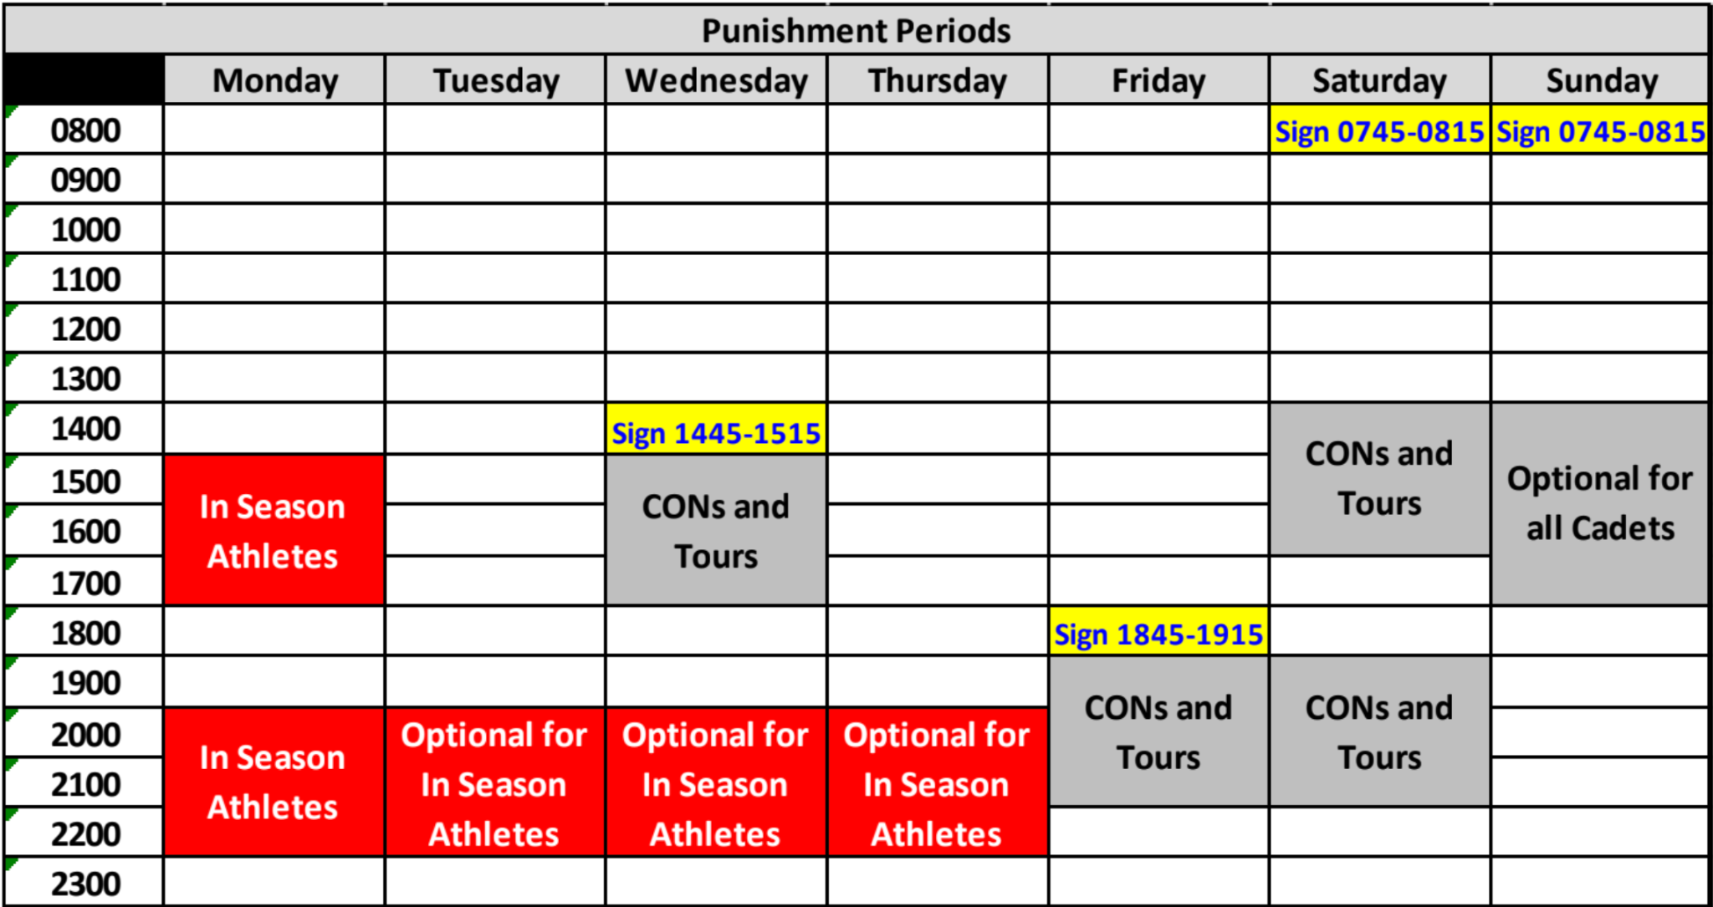
Punishment Periods
Athletes serving optional Cons/Tours must inform their company XO and the CDO 24 hours prior to serving punishments. They will serve these in their barracks rooms. These punishment periods are posted on the training schedule, and this table.
Athletes sit Cons in their rooms while on in-season orders, but will walk Tours for serious offenses, by the discretion of the Regimental Adjutant or COL Hutson.

Slide 11
Company Duty Officer (CDO) Tasks
Conduct formations for cadets with cons in front of company letter ten minutes prior to the beginning of the punishment period (Mandatory for CDO’s).
Monitor Cons.
Take roll, inspect for proper uniforms, ensure cadets sign restrictions. (Cons - Duty, no need for waist plate, gloves, or service cover)
Conduct all-ins at the company level. Do not be late.

Slide 12
NCO/CPL Tasks
NCO of the Duty Team:
Assist the senior as he or she needs.
Monitor optional Cons for in-season athletes in barracks rooms- check training schedule for times.
Uniform for In-Season Athlete Cons: Duty
Help lead the punishment formations at the company level.
Corporal of the Duty Team: Assist the NCO/Junior as he/she needs. Recommended: Split up the divisions for all-ins. Only the CDO will conduct 4th div. All-In’s until Parents Weekend.

Slide 13
Punishments

Slide 14
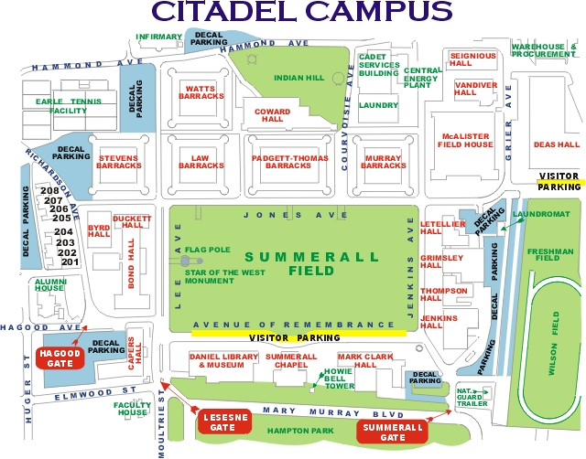
BDO Table
Formation

Slide 15
Punishment Set Up
BDOs will be set up with the BDO table in front of the rear sally port NLT 20 minutes before the start of punishments.
BDOs will put tables away in the rear sally port once tours have been completed. *PT table will be moved out of the way for tour walkers in 5th*
The CDO watching the 1st hour of cons will bring an official sign in sheet to the con room where it will remain until punishments have been completed.

Slide 16
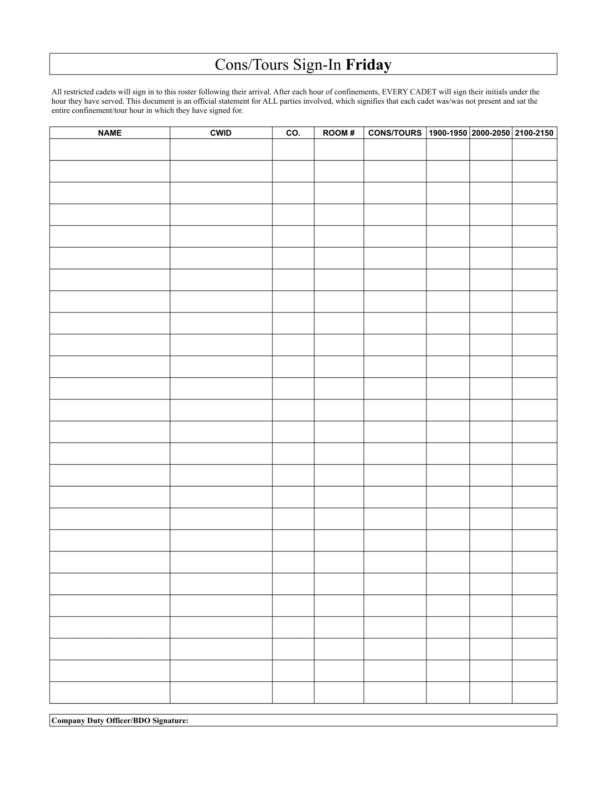
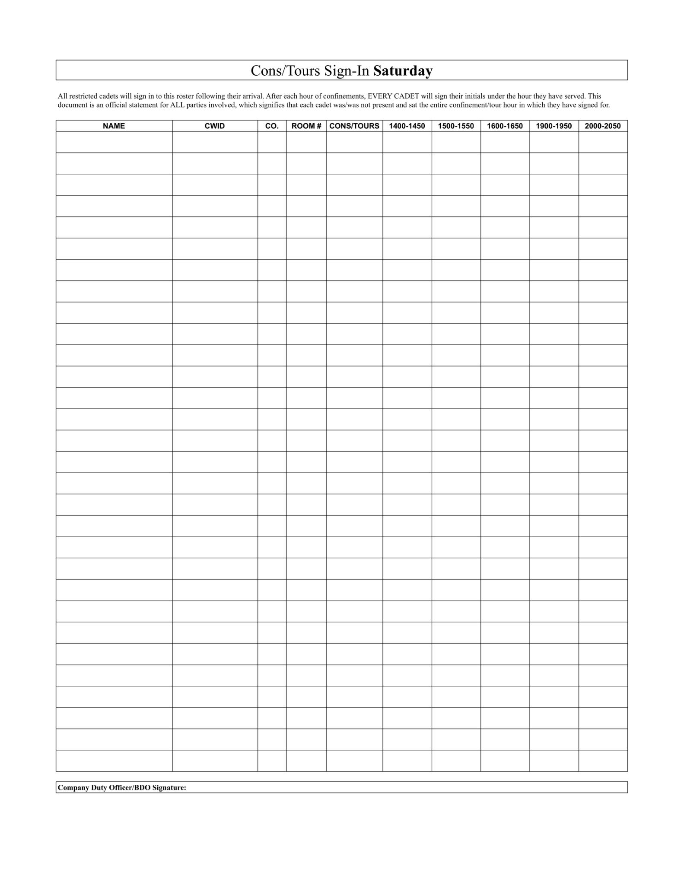
Sign-in Sheet
Cadets will write their name & CWID upon arrival to their punishment area.
*NAMES WILL BE LEGIBLE, OR NO CREDIT GIVEN*
After each hour, they will initial under the hour they have served.
CDO or BDO must sign the sheet everyday- All BN Clerks have prepared these sheets, they are located in each BN Guard Shack. Pick them up.
Sheets will be turned in to the SDO NLT 19:50 Sunday & Wednesday.
Room #

Slide 17
Sign-in Sheet
YOU WILL USE THE OFFICIAL SIGN IN SHEET. NOTEBOOK PAPER WILL NOT BE ACCEPTABLE.
No sign in sheets available? All Clerks on campus have access to be able to print extra copies of all sign in sheets.
Room #

Slide 18
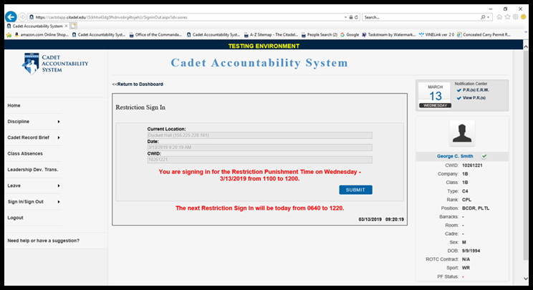
Restrictions – Cadets will only sign once a day
Attestation Statement: “I attest that I remained within The Citadel’s campus limits, as outlined in the College Regulations (Section 1, para 13), during the entire Restricted period. I understand that by not signing this document I am not admitting guilt, but recognize that I will get a Performance Report for AWOL While Restricted, Class I offense, Code 007, punishable up to 60D/120T and a battalion transfer. I will be afforded the opportunity to write an ERW to explain my circumstances such as special leave/pass/orders or that I completed my punishments during the Restricted period.”

Slide 19
Restrictions – Cadets will only sign once a day
Restriction Sign In:
Sign in Times will be 1900 Friday, 0800 Saturday & Sunday, & 1500 Wednesday

Slide 20
Tours
Procedure:
All Tour walkers will serve Tours in their BN.
Maximum: 16 tours a cadet may serve per week.
BDOs monitoring Tours must record punishments each hour at the top of the hour. BDO’s will be present in each BN during the entire punishment period during Tours.
Due to Sunday's being optional there is no CAS access to give credit for punishments. The sign-in sheet will ensure cadets get their earned credit for Sunday’s.

Slide 21
Tours
Senior Duty Team Members will have the ability to access CAS and assign Confinement/Tour Credits.
At the end of each 50-minute period, the BDO/SDO will mark cadets present for Tours.
The Regimental Adjutant or the SDO will make the call for ‘Cons for Tours’ if the situation calls for it, and cadets will sign for Tours while doing Cons.
Tours will be moved to the galleries if it rains.

Slide 22
Cons
The Company Duty SENIOR (Not the NCO or CPL) will be responsible for providing Con credit. The first CDO on Duty will bring a sign in sheet to the Con Room where it will remain until cons are completed.
Restricted cadets will sign-in when starting Cons.
The CDO is responsible for insuring cadets are studying with approved activities during the Con period. (Academics only)
At the end of the confinement hour, each confined cadet gets a 10-minute break. No items in con rooms are to be rearranged and no plugs are to be unplugged.
NOTE: Food & beverages are prohibited at all times during cons. Cadets will only bring water, which they may have during cons. This includes CDO’s and Duty Team members.

Slide 23
Failure to provide TOUR/CON credit by a BDO/CDO is Neglect of Military Duty - by order of the Commandant.

Slide 24
Punishment Periods (posted on the training schedule)
Wednesday: 1500-1800
Friday : 1900-2200
Saturday : 1400-1700, 1900-2200
Sunday : 1400-1800
1st BN = Jenkins 311
2nd BN = Jenkins 306
3rd BN = Jenkins 307
4th BN = Jenkins 310
5th BN = Jenkins 313

Slide 25
Con Room Locations (posted on training schedule)
1BN: Jenkins 311 2BN: Jenkins 306 3BN: Jenkins 307 4BN: Jenkins 310 5BN: Jenkins 313
1st BN = Jenkins 311
2nd BN = Jenkins 306
3rd BN = Jenkins 307
4th BN = Jenkins 310
5th BN = Jenkins 313

Slide 26
Cons Monitoring Schedule FRIDAY
1BN: TH 326 Alpha Senior (1900-2000) Bravo Senior (2000-2100) Charlie Senior (2100-2200) 2BN: TH 316 Hotel Senior (1900-2000) Band Senior (2000-2100)
Golf Senior (2100-2200)
4BN: TH 315 November Senior (1900-2000) Oscar Senior (2000-2100) Romeo Senior (2100-2200) 5BN: TH 216 Papa Senior (1900-2000) PB Senior (2000-2100) Sierra Senior (2100-2200)
3BN: TH 317 India Senior (1900-2000) Kilo Senior (2000-2100) Lima Senior (2100-2200)
1st BN = Jenkins 311
2nd BN = Jenkins 306
3rd BN = Jenkins 307
4th BN = Jenkins 310
5th BN = Jenkins 313

Slide 27
Cons Monitoring Schedule SATURDAY
1BN: JH 311 Delta Senior (1400-1500) Alpha Senior (1500-1600) Bravo Senior (1600-1700) DINNER BREAK Charlie Senior (1900-2000) Delta Senior (2000-2100)
Alpha Senior (2100-2200) 2BN: JH 306 Golf Senior (1400-1500) Hotel Senior (1500-1600)
Echo Senior (1600-1700) DINNER BREAK Fox Senior (1900-2000) Golf Senior (2000-2100) Band Senior (2100-2200)
4BN: JH 310 Tango Senior (1400-1500) November Senior (1500-1600) Oscar Senior (1600-1700) DINNER BREAK Romeo Senior (1900-2000) Tango Senior (2000-2100)
November Senior (2100-2200)
5BN: JH 313 Victor Senior (1400-1500) Papa Senior (1500-1600) PB Senior (1600-1700) DINNER BREAK Sierra Senior (1900-2000) Victor Company (2000-2100) Papa Senior (2100-2200)
3BN: JH 307 Mike Senior (1400-1500) India Senior (1500-1600) Kilo Senior (1600-1700) DINNER BREAK Lima Senior (1900-2000) Mike Senior (2000-2100)
India Senior (2100-2200)
1st BN = Jenkins 311
2nd BN = Jenkins 306
3rd BN = Jenkins 307
4th BN = Jenkins 310
5th BN = Jenkins 313

Slide 28
Cons Monitoring Schedule WEDNESDAY
1BN: JH 311 Bravo Senior (1500-1600) Charlie Senior (1600-1700) Delta Senior (1700-1800) 2BN: JH 306 Hotel Senior (1500-1600) Fox Senior (1600-1700)
Golf Senior (1700-1800)
4BN: JH 310
Oscar Senior (1500-1600) Romeo Senior (1600-1700) Tango Senior (1700-1800) 5BN: JH 313 PB Senior (1500-1600) Sierra Senior (1600-1700) Victor Senior (1700-1800)
3BN: JH 307 Kilo Senior (1500-1600) Lima Senior (1600-1700) Mike Senior (1700-1800)
1st BN = Jenkins 311
2nd BN = Jenkins 306
3rd BN = Jenkins 307
4th BN = Jenkins 310
5th BN = Jenkins 313

Slide 29
All Ins
All-ins are done by Duty Teams and may be assisted by the Division Inspectors. Only the CDO (Senior) will be able to enter CAS and annotate AWOLs/Absences.
Duty teams will annotate in CAS cadets who are not in their room during the all ins. This entry must be completed NLT 0000 on weekdays & 0200 on weekends.
All-Ins at every unit level will be conducted on paper and via CAS

Slide 30
All Ins
BDOs will do all ins for the Battalion Staff and the SDO will do all ins for the Regimental Staff.
If a cadet is missing for All-Ins, you must contact said cadet immediately. CDO’s notify the BDO, BDO notifies SDO. SDO will notify the RADJ, OC and BN/CO TACs.
SDO/BDO/CDO’s are responsible for All-Ins every day. You are required to notify the OC (night TAC) once All-Ins are complete. Ensure gates are locked at the proper times (check the training schedule)
Consult training schedule or CAS to confirm all-ins times, they are subject to change.

Slide 31
ALL INS
You will be held accountable for your All Ins report. If a cadet is not present, you are obligated to mark them AWOL and attempt to contact the cadet. Failure to do so will result in severe punishment. Look out for each other.

Slide 32
Drinking Alcohol
At no time are Duty Team members permitted to consume alcohol during their term of service. Specifically,
Duty Teams will not drink alcoholic beverages at athletic games or at campus functions.

Slide 33
Other Instructions
If any problems or questions arise, notify the SDO and Adjutant.
Make sure no one is forward signing or back signing.
If cadets are serving punishments incorrectly, the Duty team will write the cadet up for improper Con/Tour or not provide any credit for that Con/Tour.

Slide 34
SDO:
NAME
PHONE
REGT ADJT:
Connor Powers
(815) 216-7922

Slide 35
Questions?

